Slide 1
Computer Principles for Programmers
Clients, Servers, Networks, and Clouds
Notes:
The first web page is found at http://info.cern.ch/hypertext/WWW/TheProject.html https://www.wired.co.uk/article/first-web-page

Slide 2
News of the Week

Slide 3
Agenda
Lecture:
Computer Networks
Cloud Computing
networking and distributed computing
types of Cloud Computing: IaaS, PaaS, and SaaS.
Clients, Servers, and Tiers
File Sharing: current issues.

Slide 4
Activity
Use Office 365's cloud based collaboration tools.
Under what conditions could OneDrive be Infrastructure as a Service (IaaS), Platform as a Service (PaaS), and Software as a Service (SaaS)?
Is entertainment (music & video) a product or a service? ~OR~ Who does social media belong to? Has the delivery medium changed our relationship to the content? Is the medium really the message?
Notes:
Microsoft Office 365 is a combined application provided by Microsoft consisting of Microsoft Office Online (for Windows and OS X), Exchange (email), SharePoint (file sharing & collaboration), storage space on OneDrive, and a number of real-time collaboration tools. Everyone at Seneca has access to Office 365.
Consider either
Is entertainment (music & video) a product or a service? ~OR~
Who does social media belong to? Who owns it? is a similar but different question.
How can stuff you posted to social media be used?
Can you change things you posted?
What can you delete about yourself?…and is it really gone?

Slide 5

Computer Networks?
Network: a set of computers connected together for the purpose of sharing resources.
Internet: a network of peer networks.
Notes:
A computer network is “a set of computers connected together” for the purpose of “sharing resources.”
The most common resource shared today is the “Internet” which is a network of peer networks.
The picture is a small look at the backbone of the Internet. Each line represents two IP addresses, length of lines = delay between those addresses. Lines are color-coded by groups of top level domain (TLD) -- Dark blue: net, ca, us; Green: com, org; Red: mil, gov, edu, other colours for different geographic groups of countries.
1996 – internet traffic at 1.9PB/month is 10X 1995. 2019 – 137PB/mo of Fixed Internet traffic, 29PB/mo of Mobile Internet traffic. Overall 2019 87X 1996
https://www.explainthatstuff.com/internet.html
Internet http://www.nickh.org/computer/glossary.html#I
The most effective productivity destroyer in business today.
Designed originally as a way for geeks to communicate with each other,
it was later found that geeks were barely able to communicate,
so it was opened up for the general public.
https://qz.com/1705375/a-complete-guide-to-the-evolution-of-the-internet/

Slide 6
Types of Computer Networks
WAN = Wide Area Network, e.g. public Internet
Intranet = inside a private network. PCs, BYOD, servers for file + print + storage + data sharing.
LAN = high speed Local Area Network for an Intranet
VPN = Virtual Private Network – remote connection to a private intranet across a public network via IP tunnelling.
MAN = Metropolitan Area Network, e.g. subway station WiFi is on a MAN from BAI Communications
Notes:
Internet is not the only public network. Public networks exist in coffee shops, on the TTC, Go Transit, airplanes, airports, Toronto Public Libraries. WIFiMap.io reports ~12,000 free public networks in Toronto. The purpose of those public networks is to connect to the Internet WAN.
Be aware, that everyone in the same coffee shop is on a single WiFi LAN Intranet. Theoretically, all devices attached to the coffee shop's WiFi could communicate directly with each other.
The coffee shop is a BYOD = Bring Your Own Device environment.
Large organizations and enterprises use VPNs allowing employees to access their company's intranet from outside the office. Site-to-site VPNs allow employees in geographically separate offices to share one cohesive virtual network. An IP tunnel is an Internet Protocol (IP) network communications channel between two networks. It is used to transport another network's protocol (your Intranet) by encapsulation of its packets within the packets sent over the Internet. VPNs use authentication, tunnelling, and encryption for secure communications over public networks.
RAN is a regional area network. This is a large network like one made by an ISP (Internet Service Provider)
https://en.wikipedia.org/wiki/Bring_your_own_device
https://en.wikipedia.org/wiki/Wide_area_network
https://en.wikipedia.org/wiki/Virtual_private_network
https://en.wikipedia.org/wiki/Tunneling_protocol
https://en.wikipedia.org/wiki/IP_tunnel

Slide 7
Success of the Internet
Standards: TCP/IP, HTTP, HTML, WWW browser
Sir Tim Berners-Lee 1990. Marc Andreessen 1993. W3C 1994.
Open Source: GNU/Linux 1991, Apache Web Server 1995
World-wide communications
Affordable bandwidth: speed+capacity grows for same $
Decentralized, cooperative infrastructure. e.g. peering Growth by cooperation. Innovation by competition.
Net neutrality: all packets are created equal
Notes:
Television was the internet of the 1960s, the telephone before that, and radio before that in the early 20th C. The telegraph (19th C) and newspapers, and before that, pamphlets in the 16th C were the internet before radio. Like the internet, they were all methods of moving information around the globe and making it accessible to people. Snail mail was delivered and picked up TWELVE TIMES A DAY in 1889 London, England; it was better than your own personal FedEx.
By the mid 1970s, the US Defense Department ’s ARPANET project had grown to 60 mainframe nodes with fixed point-to-point connections using a variety of networking protocols. This was neither scalable nor flexible for inter-networking in which multiple separate networks could be joined into a network of networks. In 1982, the Internet protocol suite (TCP/IP) became the standard on ARPANET which later grew into the Internet as we know it. TCP/IP started working in a 150+ year dive bar near Palo Alto in 1976. See https://getpocket.com/explore/item/how-the-internet-was-invented
http://info.cern.ch/Proposal.html?mc_cid=5a1c84b122&mc_eid=71134692e2 “Vague, but exciting” is what Berners-Lee's boss, Mike Sendell, wrote on the proposal for an information management system in 1989. Berners-Lee made HTTP and WWW freely available; he has fought to keep it open, non-proprietary, and free. See https://www.wired.com/2012/02/tim-berners-lee-patent/ "The reason the Web took off is not because it was a magic idea, but because I [Tim Berners-Lee] persuaded everyone to use HTML and HTTP." Back then, there were not that many everyones to persuade. Also, more importantly, because it was open and non-proprietary, and therefore free. Free as in speech and free as in beer.
The first web page is found at http://info.cern.ch/hypertext/WWW/TheProject.html https://www.wired.co.uk/article/first-web-page
The invention of HTTP Hypertext Transfer Protocol and the textual browser in 1990 by Berners-Lee called “WorldWideWeb” and Marc Andreessen’s visual GUI Mosaic three years later (→ Netscape → Mozilla → Firefox)
made the Internet easy to use and accessible to the average person (multi-media in a single window and multiple protocols like HTTP, FTP, Usenet) and sparked growing demand for connectivity in the mid and late 1990s.
Marc Andreessen https://www.wired.com/2012/04/ff-andreessen/
The Mosaic/Netscape browser software was FREE for non-commercial use. Building a business by giving stuff away was a revolutionary model.
https://www.internetsociety.org/internet/
https://www.inverse.com/article/14959-celebrating-23-years-of-the-www-how-tim-berners-lee-open-sourced-the-internet
https://home.cern/cern-people/opinion/2013/04/twenty-years-free-and-open-www
https://opensource.com/life/14/4/25-years-world-wide-web
https://webfoundation.org/about/vision/history-of-the-web/
https://www.theguardian.com/technology/2017/mar/11/tim-berners-lee-web-inventor-save-internet
https://www.vanityfair.com/news/2018/07/the-man-who-created-the-world-wide-web-has-some-regrets
http://yourlifesolution.com/7/the-man-who-would-have-been-a-trillionaire/
https://www.youtube.com/watch?v=ykCPFUlasFk (broadcast of Tuesday 12 March 2019, Science Museum & Web Foundation celebrate the web’s 30 years with Sir Tim)
In the 1990s, UNIX was dying in the small to medium sized business world with the rise of Microsoft Server. The IT trade press was predicting the demise of UNIX. In the early 1990s, IBM and Microsoft ignored the Internet as a poor public substitute for high quality private telecommunication networks. If you wanted a web server, you had to make one. Only the UNIX OS was open enough for anyone to develop applications like a web server on affordable micro hardware and deployable on mini hardware (mid-size servers) powerful enough to do the job. Both IBM and Microsoft’s servers were too closed at the time for this type of development. Researchers and innovators accepted the TCP/IP standard and embraced the idea of a network of independent networks and non-proprietary servers.
World-wide communications: 250,000 km of submarine communications cable with a capacity of 2.56 Tb/s by 2002. How did such extraordinary growth take place: fibre optic cables (they are not very big and transmit data farther so are easier to lay than traditional copper cables).
During the dot-com bubble, the days of the “information superhighway”, a large number of telephone companies, known as “telecoms”, built optical fibre networks everywhere. Telecoms were in a greed-fueled race to corner the market in telecommunications by providing a network with sufficient capacity to take all existing and forecast voice and data traffic for their entire region served. This was based on the assumption that telecom traffic, particularly data traffic, would continue to grow exponentially for the foreseeable future…and that each telecom would get their “fair share” of the market, their fair share being 100%. (Tim McKenna was at a New Years Eve party in 2001 where a “golf-pro” who was just recently a senior VP in a telecom firm, admitted that for all the sales forecasts to come true, North America would have needed well over a billion extra residents to soak up the capacity on offer.) There was willful ignorance of demographics and blindness to the limits of exponential growth. (See S curve, Logistic function, http://www.slideshare.net/wright4/double-scurve-model-of-growth)
Affordable High bandwidth: The capacity of commercial lightwave systems increased from less than 100 Mb/s when they debuted in the 1970s to roughly 1 Tb/s by 2000. This is an increase of more than 10 000 times in 30 years, but more incredibly, the introduction of WDM wavelength-division multiplexing during the latter part of the 1990s resulted in a factor of 1000 increase in just 10 years. In the early to mid 1990s as the Internet got going, data traffic was increasing faster than capacity to carry it. Telecoms rushed to put fibre everywhere and sign up ISPs. By the year 2000, the situation had reversed, capacity was greater than demand because the bandwidth of a single fibre had increased 1000 times during the decade. As a result, the wholesale price of data traffic collapsed (what your business plan expected you could sell for a $1 in 1992 was going for $0.001 – one tenth of a cent less than ten years later) and with it, the rest of the telecoms’ shaky economic assumptions (Yesterday's needs will be solved by Today's technology; Today's needs will continue Tomorrow, and Tomorrow will never have a better solution than Today's). What was only affordable for businesses throughout the 1980s became inexpensive enough in the mid-1990s for everyone who could afford a PC.
IBM and Microsoft's limited vision of expensive, inherently secure, private point-to-point networks was inexpensively satisfied by the growth of the public insecure Internet overlaid with encryption for security. More and cheaper bandwidth created new opportunities. It wasn’t just data and files going over a network, it became pictures, music, and video that could be streamed. One result of telecom greed was a lot of unlit fibre, known as "dark fibre". Dark fibre is now used for dedicated connections between a company and cloud or network services.
This dramatically reduced the demand for physical fibre by increasing the capacity that could be placed on a single fibre by a factor of as much as 100 during the dot-com bubble. In the late 1990s through 2000, the telecoms saw the market opportunity of data traffic's estimated growth rates "doubling every 100 days" which was optimistic. But they did not take into account the capacity to carry that traffic was doubling every six months starting in 1992 until a bit rate of 10 Tb/s was reached by 2001. (Proceedings of the IEEE, Volume: 100 Issue: 5. Capacity Trends and Limits of Optical Communication Networks, 2012. https://doi.org/10.1109/JPROC.2012.2182970 ) https://en.wikipedia.org/wiki/Fiber-optic_communication#History
By 2002, an intercontinental network of 250,000 km of submarine communications cable with a capacity of 2.56 Tb/s was completed.
Decentralized : No one is the “boss” of the Internet, no one company owns it. The Internet backbone is a conglomeration of multiple, redundant networks owned by numerous companies. Massive cooperative infrastructure of fibre cables in the ground and under the ocean, many core router nodes (Internet exchange points, IX or IXP) in all major cities with between 1 and 5.6 tera-bits per second capacity. https://en.wikipedia.org/wiki/List_of_Internet_exchange_points_by_size
In only ~25 years, the Internet has grown to be considered a public utility like electricity and water, computers are almost useless without network connectivity. The Internet, i.e. communication, is also considered essential to supporting human rights. Soon, it may be considered a human right in and of itself. In Summer of 2016, the United Nations Human Rights Council released a a non-binding resolution condemning intentional disruption of internet access by governments. The resolution reaffirmed that "the same rights people have offline must also be protected online.“ https://en.wikipedia.org/wiki/Right_to_Internet_access#2016:_UN_Resolution
Net neutrality is the principle that Internet service providers and governments regulating the Internet should treat all data on the Internet the same, not discriminating or charging differentially by user, content, website, platform, application, type of attached equipment, or mode of communication

Slide 8
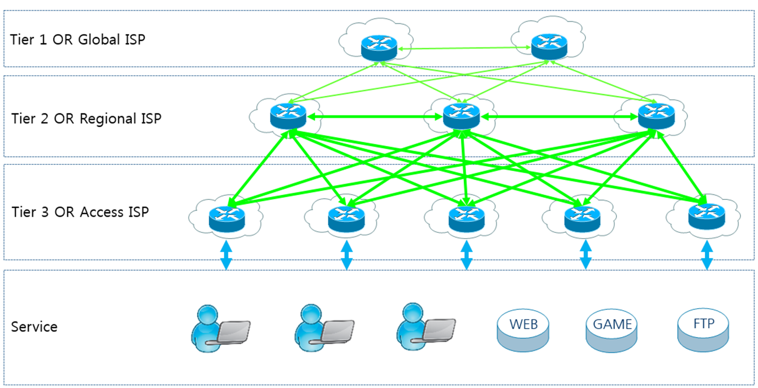
Tier 1 / 2 IXP – Internet Exchange Point Tier 3 ISP – Internet Service Provider
IXP
Peer
IXP
transit
$
Peer
Peer
IXP
transit
$
ISP
transit
$
2B PCs 1B tablets 5B smartphones
Notes:
Growth occurred because of cooperation, innovation because of competition. It was a healthy balance.
The Internet is a collection of separate and distinct networks, each one operating under a common framework of globally unique IP addressing and global routing (each network exchanges routing and reachability information for all other networks). Peering involves two networks coming together to exchange traffic with each other freely, and for mutual benefit. This 'mutual benefit' is often "reduced costs for transit services". neither party pays the other in association with the exchange of traffic; instead, each derives and retains revenue from its own customers within its own network. https://en.wikipedia.org/wiki/Peering
Tier 1 networks peer with each other exchanging traffic without charge but charge their Tier 2 customers for 'transit'
Tier 2 networks peer with each other exchanging traffic without charge but charge their Tier 3 customers for 'transit'
Tier 3 networks charge you for transit.
See https://www.mckinsey.com/industries/private-equity-and-principal-investors/our-insights/growing-opportunities-in-the-internet-of-things
Business model: peering (cooperative, no charge for exchanging traffic) and transit (competitive, chargeable)
Peering involves two networks coming together to exchange traffic with each other freely, and for mutual benefit. This 'mutual benefit' is often "reduced costs for transit services". neither party pays the other in association with the exchange of traffic; instead, each derives and retains revenue from its own customers within its own network. https://en.wikipedia.org/wiki/Peering
A peering relationship is one by which you and another entity exchange traffic for each others' customers, and no one else. (between Tier 1 Internet Exchange Points and within a Tier 2 Internet Exchange Point) When a provider bears traffic for you that is not destined for their customers, you are paying for transit from them. (between Tier 2 IXPx and all Tier 3 networks)
https://en.wikipedia.org/wiki/Tier_1_network
Tier 1 networks (e.g. Amanah in Toronto), which can reach any other network on the Internet, are all peering networks, i.e. "transit free"; Tier 1 networks do not charge other Tier 1s for TCP/IP traffic. But they do charge Tier 2 networks for "transit".
Tier 2 networks (e.g. Toronto Internet Exchange Community–TorIX–https://www.torix.ca/– one of the largest internet exchanges in the world, TorIX members freely exchange each other's traffic) pay Tier 1s for transit to other networks, and charge transit from Tier 3 networks.
Amanah and TorIX (and Coligix and Neutral Data Centres and others) are located in Canada's premier International Telecom Carrier Hotel and Data Center at 151 Front St. West in Toronto (and also at 45 Parliament Street). It is the safest building in the city and the most connected telecom facility in the country with 25 diverse fibre-optic points of entry into the building. It utilizes the latest technologies in advanced direct power feeds, deep water cooling systems, rooftop generators, fire safety, and high-tech security surveillance. See https://www.theglobeandmail.com/report-on-business/a-telecom-nerve-centre-to-a-nation/article560097/
Tier 3 Internet Service Providers (ISPs) initially charged only for connection, not usage. like the telephone, you can talk all you want once you have a connected phone. In the early days, data usage was not metered. Data consumption was limited by slow connections. As connections got faster, applications, web sites, and file sharing became data hungry. Then the tragedy of the commons happened: data was free! so everyone just left the lights on and the taps running. Higher speeds turned into less throughput as bandwidth became saturated. Data consumption came to be metered at the customer level to provide balance and fairness in the overall system or to bilk your bank account depending on your ISP. More recently, with improvements to networks and especially to the last mile (fibre to the premises), data caps are coming off. (Big ISPs hope to control that by getting rid of net neutrality.)

Slide 9
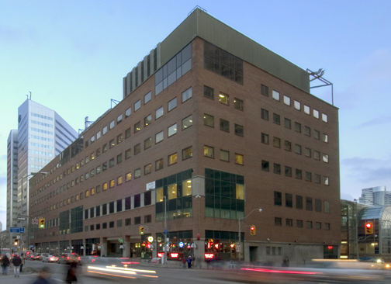
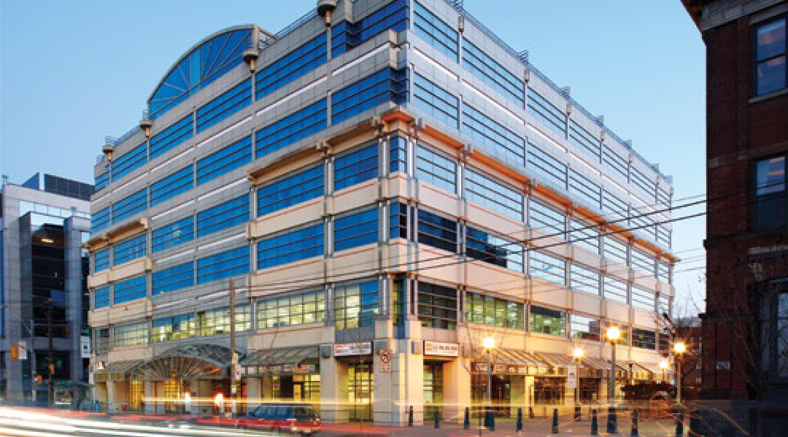
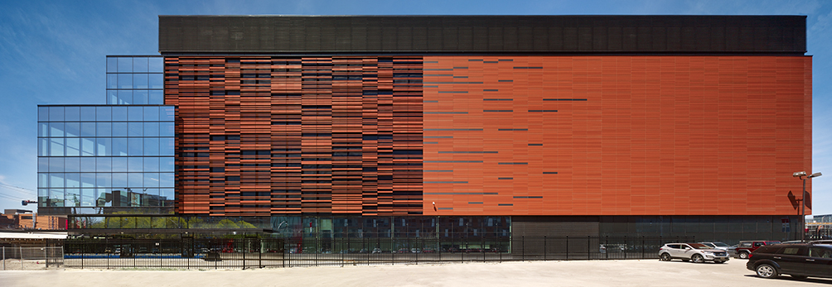
151 Front St W
905 King St W
Toronto carrier hotels
Tier 1 & 2 connect at IXP Internet eXchange Points for peering and transit.
45 Parliament St
Notes:
https://www.theglobeandmail.com/report-on-business/a-telecom-nerve-centre-to-a-nation/article560097/
151 Front St W Toronto (top left)
905 King St W Toronto (top right)
45 Parliament St Toronto (bottom)
Use Google maps to look at the tops of those buildings.
Toronto Internet Exchange Community (TorIX) is an Internet eXchange Point.
TorIX is not-for-profit organization which, as of October 2019, has 257 unique autonomous systems representing 278 peer connections and peak traffic rates of 724 Gbit/second.
https://en.wikipedia.org/wiki/Toronto_Internet_Exchange
https://www.torix.ca/
https://www.torix.ca/peers/ – sort by Gbits/sec column to see familiar Internet companies: Cogeco Cable, Amazon, Facebook, Google, Microsoft, Teksavvy
Companies with ASN Autonomous System Number and a presence in one of the above carrier hotels can peer with each other. The Exchange operates a members-only portal that allows peers to publish their peering policies, contact other members with peering requests, configure route-server access and options, track traffic usage, etc.
The peering traffic is free, the 100GB/sec inter-networking connection to other peer companies through TorIX is not.
https://ipinfo.io/countries/ca – list of Canadian organisations with ASN Autonomous System Numbers
https://ipinfo.io/AS10265 Seneca College of Applied Arts and Technology with up to 65,536 IP addresses currently active on each network. (Does 65,536 look familiar? It is the number of values a 16-bit integer can hold.)

Slide 10

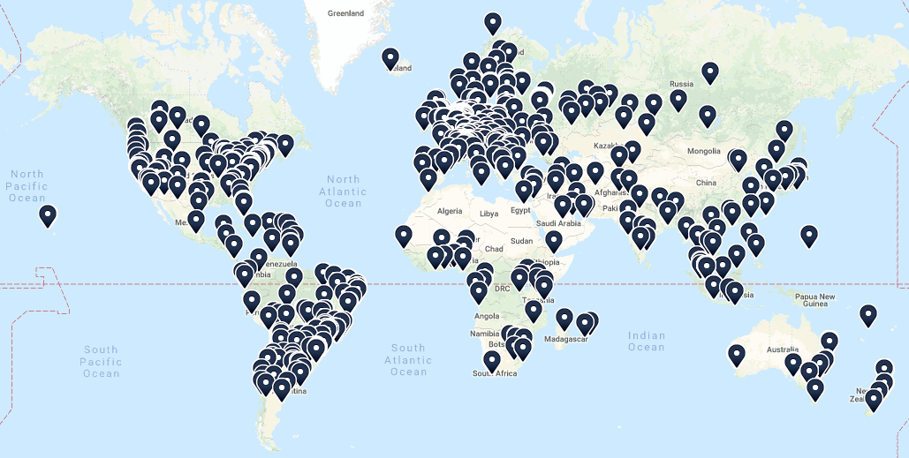
Tier 1 & 2 Internet Exchanges
Notes:
https://www.dw.com/en/the-worlds-biggest-internet-hub/av-37146102
https://www.internetsociety.org/issues/ixps/
https://www.ixptoolkit.org/ixps/
https://www.internetexchangemap.com/
Zoomable map. Can drill down to a street address.
TORIX
https://www.internetexchangemap.com/#/building/8158
https://www.torix.ca/
https://ix.equinix.com/
https://www.megaport.com/

Slide 11
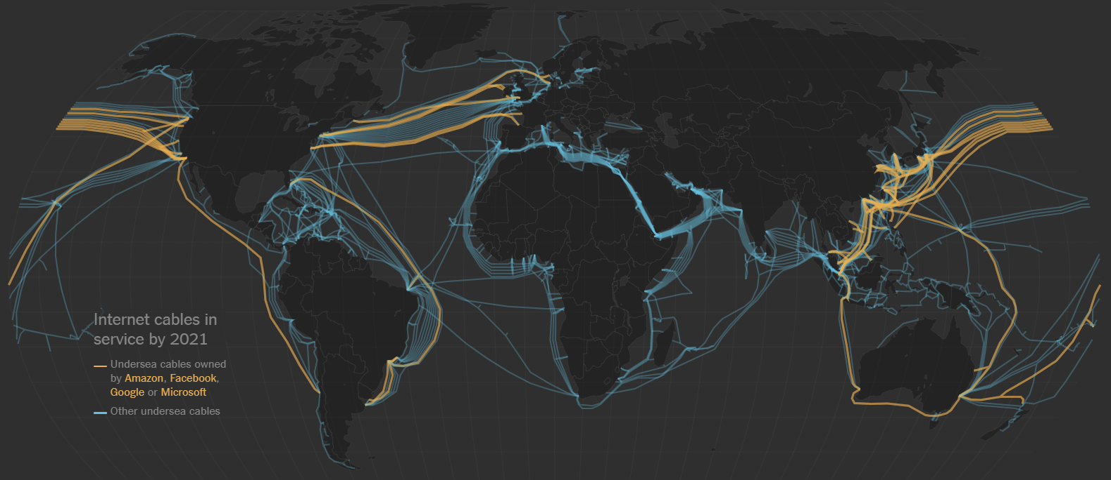
IXPs connected through the oceans
Notes:
https://www.nytimes.com/interactive/2019/03/10/technology/internet-cables-oceans.html
"about 1.2 million kilometers of cable connect the continents in 2019" or 3 times the distance to the moon.
https://www.submarinecablemap.com/
Content providers like Microsoft, Google, Facebook and Amazon now own or lease more than half of the undersea bandwidth. They maintain their own private world-wide networks co-located and interacting with Tier 1 & 2 providers in IXPs.
Google has 13 data centers open around the world, with eight more under construction — all needed to power the trillions of Google searches made each year and the more than 400 hours of video uploaded to YouTube each minute. Demand for undersea cables will only grow as more businesses rely on cloud computing services and the use of artificial intelligence increases. Areas in the world without internet access are now getting access, with the United Nations reporting in 2019 that, for the first time, more than half the global population is now online.
But, in Africa, only a quarter have online access due to lack of infrastructure and high cost. See https://qz.com/africa/1656262/google-facebook-building-undersea-internet-cable-for-africa/
How Netflix works: the (hugely simplified) complex stuff that happens every time you hit Play https://medium.com/refraction-tech-everything/how-netflix-works-the-hugely-simplified-complex-stuff-that-happens-every-time-you-hit-play-3a40c9be254b

Slide 12
The Internet is brought to you by…
Browsers (Firefox, Chrome) parse and organize Internet content into a consumable form for end users
Search engines (Google, Bing) help you discover online content
Content creators author the content you see online. (Human beings who need to eat just like you do.)
Platforms (Facebook, Shopify, Wordpress, Drupal, LAMP, ASP.NET) where the content is published
Hosts (matrix, Amazon Web Services, WHC.ca, Rackspace) provide infrastructure where the platforms live
Internet Service Providers (ISPs) (Teksavvy, Bell, Rogers) connecting end users to the Internet (Tier 3)
Transit Providers connect you from the last mile (Tier3 ISPs, Tier 2) to the rest of the Internet (Tier 2 & 1)
Reverse Proxy/CDN^{[1]} (Akamai, Cloudflare) provide networks to cache content and protect from attack
Recursive DNS^{[2]} providers (OpenDNS, Google) cache info to resolve end users' DNS queries quickly
Authoritative & Root DNS (Dyn, Cloudflare) official reference of domains, names, and related IP addresses
Registrars (Tucows) registers domain names. ICANN^{[3]} governs internationally. https://whois.icann.org/en
Registries (cira.ca, Verisign) administer top level domains (TLD) .ca, .com IANA & RIR^{[4]} govern the TLDs
[1] CDN = Content Delivery Network distributes traffic better than a single server and protects from DDoS attack
[2] DNS = Domain Name System/Services translates human usable domain names into IP addresses
[3] ICANN = Internet Corporation for Assigned Names and Numbers sets rules for Registrars and Registries
[4] IANA = Internet Assigned Numbers Authority & RIR = Regional Internet Registries provide IP addresses used by Registries and Registrars.
Notes:
Yes, this slide has way too much info on it, done just to emphasize the many "moving parts" it takes to make the internet work.
It's not on the quiz.
https://www.internetsociety.org/internet/
DNS = Domain Name System/Services
The Internet Corporation for Assigned Names and Numbers (ICANN) governs protocol parameters, Internet number resources (IP addresses) and domain names (through IANA) on behalf of the global Internet community.
https://www.icann.org
https://www.apnic.net/about-apnic/organization/history-of-apnic/history-of-the-regional-internet-registries/
Speed, Security, and Safety Through DNS.
https://umbrella.cisco.com/blog/2013/12/11/speed-security-safety-dns/
What Is the Difference between Authoritative and Recursive DNS Nameservers?
https://umbrella.cisco.com/blog/2014/07/16/difference-authoritative-recursive-dns-nameservers/
A useful description of how the internet works is found at
https://www.eff.org/document/internet-engineers-commentsfcc-nn
https://cira.ca/blog/information-technology/infographic-%E2%80%93-dns-canada
https://www.dnsperf.com/

Slide 13
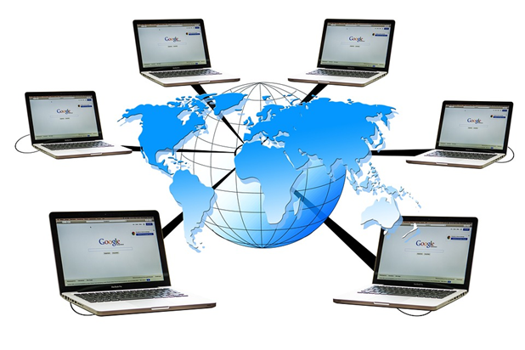
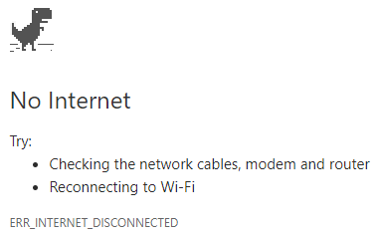
What are the issues of shared computing and networking?
Downasaur
How do you feel when this happens?
Notes:
"We as a society chose to get more connected, and one of the perils of doing that is, the more connected you are with everybody, the more connected you are with malicious people as well." -- Scott Culp, Manager - Microsoft Security Response Center
The Bad News
Need for security and firewalls, user IDs and passwords, Malware protection
Privacy, “would you like to share your location?”
Hacking, phishing, ransomware, spoofing, spyware, packet sniffing, worms,
Email overload and spam
BOTS, DDoS attacks, reliance on Internet as a utility or a road – you expect it to be there.
The Good News
Ordering a pizza, e-commerce, online shopping.
Wikipedia and the world-wide sharing of information. See https://wikimediafoundation.org/wiki/Home
Connecting people with common interests who would never otherwise know each other
Cheap long distance telephone rates
Wireless, i.e. Mobile communication, because the demand for easy and ubiquitous communication was so strong.
multiplayer online games and virtual reality communities,
accessible information processing systems such as banking systems and airline reservation systems that previously required a visit to a bricks & mortar location where experts used the systems on your behalf.
Uber, AirBnB – now you can know who to get a ride from or who you can stay with in another city.

Slide 14
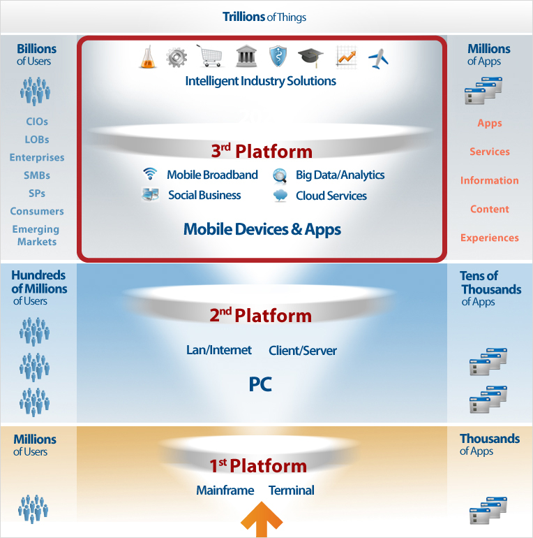
Notes:
General computing platforms
Graphic from https://idc-cema.com/eng/consulting/technologies
https://en.wikipedia.org/wiki/Third_platform
https://www.forbes.com/sites/steveandriole/2019/02/06/the-microsoft-amazon-ibm-google-clouds-enable-emerging-technologies-and-everything-else/
https://www.infoworld.com/article/2683784/cloud-computing/what-is-cloud-computing.html
https://www.datamation.com/amp/cloud-computing/how-the-public-cloud-drives-emerging-technologies.html
CIO = Chief Information Officers
LoBs = An LOB (line-of-business) is a general term that describes the products or services offered by a business or manufacturer. A company that manufactures solid state disk drives, for example, might claim their LOB is data storage.
Enterprise = a for-profit business or company. In the context of ICT, it often means 'systems at scale' to support a very large business.
SMB = Small to Medium sized Business. aka SME Small to Medium sized Enterprise
SP = Service Provider
Emerging Markets = growing economies
https://www.raconteur.net/technology/cloud-computing-emerging-markets http://conferences.computer.org/ccem/about.html
https://www.i-scoop.eu/digital-transformation/the-third-platform/
https://www.itworldcanada.com/article/master-third-platform-technologies-with-these-3-experts/397842

Slide 15
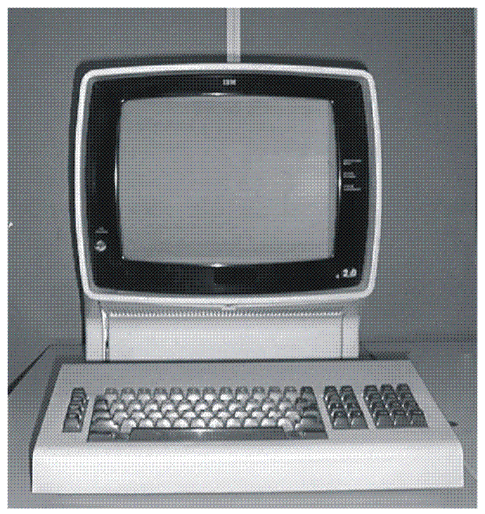
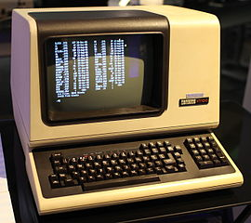
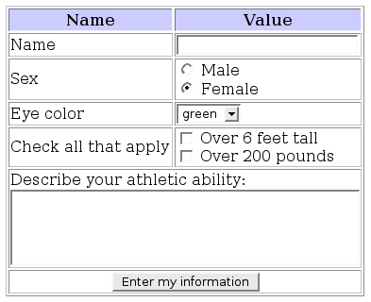
Dumb Terminals & Single-Tier Architecture One server does all thinking, processing, storing. Terminal / Thin client does presentation only as directed by the server.
IBM 3270, 1971
DEC VT-100, 1978
Thin Client HTML5 + CSS3 + JS
Notes:
Dumb Terminals & Single-Tier Architecture = client does not change, does not have its own 'state' or local persistent storage.
Only the server's state changes and only it has persistent storage. The client's actions are determined by the server; the client does not make its own decisions. The client stays the same.
In the 1970s and 1980s, IBM had "intelligent" block mode terminals which recognized their own keystrokes and exchanged a formatted stream of data with the host instead of just single characters as in the case of UNIX terminals. IBM 3270 terminals were used with mainframes and 5250 terminals were used with mid-range computers. You will program IBM 5250 terminals in the BCI433 course. These IBM terminals had similar functionality to a browser's HTML3 + simple JS using a Textual User Interface.
https://www.ibm.com/support/knowledgecenter/zosbasics/com.ibm.zos.znetwork/znetwork_261.htm#znetwork_261__disp3270
The DEC VT-100 (1978) established the standard for terminal connections to UNIX hosts. It was a video display implementation of old teletype terminals which input from keyboards and punched paper tape and output by printing on a roll of paper similar to a typewriter (line feeds and carriage returns). This “dumb” terminal had lots of smarts for cursor and color control making the entire 24 line by 80 column screen addressable and controllable by a program using ANSI escape codes, i.e. a sequence starting with the character ESC, ASCII decimal 27. These sequences told the terminal to underline, dim, reverse-video, or change colour using line/column coordinates, and especially to simply clear the display and position the cursor. Terminals were "dumb" because they interrupted the host computer at each keystroke. A keycode was sent from the terminal's keyboard to the host computer which recognized it send a code back to the terminal to display, for example, an "a" on the screen. This is why you can type ahead of the display… it c a n t ak e a long time fo r a charac ter to ma ke a round trip from keyboard to s c r een.
See
https://en.wikipedia.org/wiki/Computer_terminal
https://en.wikipedia.org/wiki/VT100 and https://en.wikipedia.org/wiki/ANSI_escape_code
http://www.pcmag.com/feature/348634/the-forgotten-world-of-dumb-terminals
PuTTY is a terminal emulator you likely use to sign on to matrix. “TTY” means TeleTYpe. Look at the Terminal features inside the PuTTY config, you’ll see VT-100.
Browsers and HTML Forms.
Image By File Upload Bot at the English language Wikipedia, CC BY-SA 3.0, https://commons.wikimedia.org/w/index.php?curid=9000152
Now, browsers are the “dumb” terminals as were early Google Chromebooks. Although PuTTY and browsers are software that must be installed on a PC, they are not independent client applications. They are terminal emulators or presentation devices under the control of a server.
With HTML5 + CSS3 + JavaScript, web apps can appear as smart as a Client-Server application…but they are not because they cannot change the state of the client system. It is amazing how much can be done through a browser these days, e.g. Office 365 apps and email. But, no matter how smart the browser tab appears, it is still the server telling the client what to do and the data exists only on the server. Functionality is limited by the browser and JavaScript (e.g. browser's security sandbox). A thin client application will not run without a connection to the server, it stores none of the application data (just settings in cookies). Applications that require a high degree of user interaction can feel slow even over a fast network due to latency.
HTTP and the IP part of TCP/IP (.../Internet Protocol) is a stateless protocol which means that the connection between the browser and the server is lost once the web page is loaded. The server forgets about the client. The stateless design simplifies the server design because there is no need to dynamically allocate storage to deal with signed on sessions. If a browser shuts down in mid-transaction, no part of either system is responsible for cleaning up the session state on the server. A disadvantage of statelessness is that it may be necessary to include additional information in every request, and this extra information will need to be interpreted by the server. As a work-around for the lack of a session layer in HTTP, HTTP servers implement various session management methods typically utilizing a unique identifier in a cookie or parameter that allows the server to track requests originating from the same client, and effectively creating a stateful protocol on top of HTTP. That, and a lot of smart JavaScript makes many web applications look stateful. https://en.wikipedia.org/wiki/Stateless_protocol
https://www.google.com/chromebook/
https://www.google.com/chromebook/switch/ -- OOPS! it doesn’t do Skype. Like iOS doesn’t do Flash.
https://www.cnet.com/news/the-five-stages-of-chromebook-acceptance/
https://www.atlantic.net/community/whatis/stateless-and-stateful-models-of-web-development/
https://launchschool.com/books/http/read/statefulness
https://petabridge.com/blog/stateful-web-applications/

Slide 16



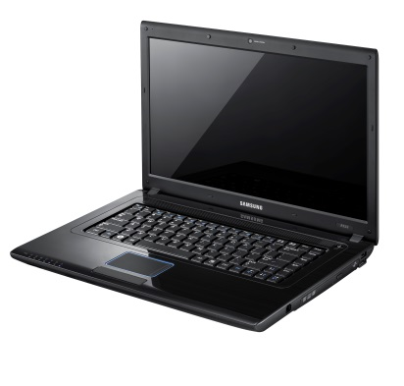
Two-Tier Architecture — Client–Server Model
user's transactions submitted to server
Protocol
state of user's data received by client
Server/Host Business
centralized: multi-user processing, data store, communication with other systems
Server Thick Client
App Server ←|→ s-phone App Exchange ←|→ Outlook
POP, IMAP ←|→ Thunderbird Google ←|→ Chromebook FTP Server ←|→ FTP Client
Client is User Facing
distributed: advanced presentation, user data management; tells server what to do
Notes:
Two-Tier Architecture = a thick client changes, it has its own 'state' and persistent storage (as does the server).
The server coordinates with other systems and synchronizes it's state with the client upon request; the synchronization is bi-directional. e.g. email server sends/receives messages for the client.
In a Two-Tier application, processing is shared between distinctly different programs running on server and client. With this architecture, it is the client that tells the server what to do. Client and Server are different and independent applications sharing a common protocol.
A server supports connections to multiple clients and users ("one to many"). A client maintains a session with a single server ("one to one").
Difference between thin (single-tier) and thick/fat (two-tier) clients
Thin: server tells client what to do to interact with a user; client cannot run without a connection to server. Thin clients run inside another application such as a browser or PuTTY which emulates terminal firmware. Only the state of the server is changed, e.g. a database record is updated. The client side remains the same.
Thick: client tells server what to do, client is able to perform application work without a connection to server. Thick clients run on the local OS and store data locally.
See https://www.webopedia.com/DidYouKnow/Hardware_Software/thin_client.asp
In recent years, Chromebooks have come with some local storage; with configuration effort and planning, they can be useful offline and can be considered thick clients.
Smartphone apps are often in between thin and thick clients. They are thick in that they can store their own 'state' and data. However, many are thin in that they do not run without a server connection. New technologies like CloudDB and concepts like http://offlinefirst.org/ are making mobile apps more like traditional client-server architecture.
PouchDB allows web developers build browser applications that work as well offline as they do online. It enables applications to store data locally while offline, then synchronize it with CouchDB when the application is back online. https://pouchdb.com/ This further blurs the line between thin and thick clients.
Why bother with an intelligent thick/fat client in this day and age? Because the network is still too slow and servers too busy to handle the sophisticated UI of applications with the responsiveness users expect. Also, the user's data set can be quite large. Functionality is not as limited on the client platform as it is within a browser's web app. (e.g. web app security is bound by the browser's security sandbox whereas local client apps are bound by local permissions which can be to everything.) Client applications with a high degree of user interaction are as fast as the local hardware and have all the UI sophistication of the local platform – this is why there are so many smartphone apps. Almost all of those apps could exist within an HTML5 + CSS3 web app run in a browser but the browser + communications + server overhead can make web apps with a high degree of user-to-server interaction feel slow, are running with a non-native UI, and have to fetch a lot of data from a remote system. See http://offlinefirst.org/ and http://hood.ie/blog/say-hello-to-offline-first.html
See https://medium.com/all-technology-feeds/cross-platform-vs-native-mobile-app-development-choosing-the-right-dev-tools-for-your-app-project-47d0abafee81 and https://www.joshmorony.com/7-lessons-from-3-years-of-html5-mobile-application-development/ and https://www.mobilesmith.com/html5-vs-native-debate-is-over/ (entirely self-interested in selling you their product but a good pro/con summary)
A client application, usually in the form of a compiled locally installed program or "app", establishes a connection with a server. The server typically handles the database and performs business-side functions. The client takes care of the user interface and stores the user's data set; it handles the selection and presentation of data records (sorting, filtering, calculations), validates user input, and commits a transaction to the server. CRUD (eventually) happens on the Server but starts on the Client: Create, Read, Update, and Delete records in a database.
Smart clients can also contribute to fault tolerance by buffering and storing transactions when a connection with the server is interrupted, load balancing is the client doing the work of presentation and validation locally. Security can be enhanced by using proprietary protocols between client and server and by maintaining “stateful” connections. A stateful connection is two systems remaining connected, either can talk to the other, both remember the state (who is signed on, data, multi-stage transactions in progress), the connection is kept open even though the two systems might not be transmitting information (i.e., the connection itself retains state), the connection ends deliberately with a sign off process. A telephone call between two people is a stateful connection.
An application has its own compiled client program running on the local OS which serves as its user interface and had to be separately installed on each user's personal computer. An upgrade to the server-side code of the application would typically also require an upgrade to the client-side code installed on each user workstation, adding to the support cost. In addition, both the client and server components of the application were usually tightly bound to a particular computer architecture and operating system and porting them to others was expensive. (Today, native apps for mobile devices can be hobbled by some or all of the foregoing issues.)
See https://en.wikipedia.org/wiki/Web_application#History

Slide 17
FTP needs Client–Server applications
Client authenticates and makes a connection
Client navigates to directories on both sides
Client requests, Server sends or accepts data
FTP Server OS File System Filename data
Local FTP interacts with local Operating System. Each OS maintains its own file system. File attributes/metadata are not necessarily transferred.
Only data is exchanged between platforms.
FTP Client OS File System Filename data
Notes:
The FTP client is a thick client, it tells the server what to do. Thick clients run on the local OS. A thick client performs local file management (changes its persistent state) with or without a connection to a server.
FTP, File Transfer Protocol, needs client – server applications. The protocol allows diverse systems to work with each other. The FTP server and FTP client are different software applications both in function and implementation. The FTP server makes changes to its local file system (receives or sends a file) only under the direction of an FTP client.
After signing on, the client program navigates to the server side directory and its own client side directory. The FTP client app is subject to the server granting authority for the client's user to access a location in the server's file system. The client sends commands to list a directory, or to get or put a file. In a GUI interface, FTP commands are interpreted from click and drag mouse movements.
It seems like a file is being transferred between the two systems but the basic FTP protocol sends only the filename and data. Fidelity relies on the two FTP apps negotiating and resolving differences between their respective systems. Two very separate client and server applications are needed to insulate each other from diverse operating systems, file systems, and character representations. Differences between the client and server platforms are translated by the respective FTP apps.
File attributes and metadata can (and likely does) vary on the two systems. Both the matrix FTP server and WinSCP & FileZilla clients support the MFMT (Modify File Modification Time) command which extends the FTP protocol (SCP = Secure Copy Protocol). However, if either the FTP client or server does not support the extension, the file's original timestamp is lost and is given the current timestamp on the receiving system.
The two systems may use different binary representations of data. e.g. ASCII, EBCDIC (IBM), or Unicode implementations (UTF-8 -16 -32, UCS-2). Differing native character sets can result in file names and/or data not being faithfully translated. A text/source file's line break character(s) are CR LF in Windows, LF in *nix including Apple OS X… , CR in classic Mac. Binary data can be transferred without translation but the user must be aware that the two systems are compatible.
There may be conflicts / different behaviours when one system uses case independent file names and the other case dependent names. A *nix FTP server can have separate files named "fileABC" and "FILEabc". The FTP client must be case specific to get one of those files. If the FTP client is on a platform where the file system is case independent, such as Windows or IBM, getting either "fileABC" or "FILEabc" from the FTP server will replace "FILEABC" on the client side. Putting "FILEABC" from the client to the server without a target filename will result in three different files on the server.
Students may have noticed the above issues when transferring their C source code files from Windows or macOS to the matrix server.
Notes for ICT people using FTP with command line or GUIs can be found at
https://www.linkedin.com/learning/learning-ftp/what-is-ftp?u=2169170
https://deliciousbrains.com/how-unicode-works/

Slide 18
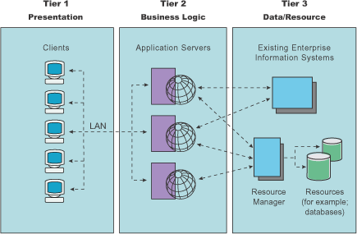
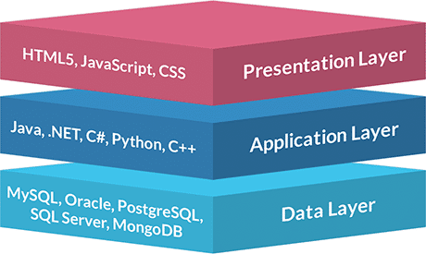
Three-Tier or N-Tier Architecture
Notes:
3-Tier Architecture was invented to avoid many problems and issues with 2-Tier, Client-Server business applications…where presentation and business application logic were in a resident client program with primarily data storage & database on the server side.
In software development, the analog of three-tier is known as MVC, Model – View – Controller, architecture.
In overall systems development, 3-Tier Architecture is divided into 3 layers:
Presentation Layer at Client (VIEW)
- User interface, input validation (values and simple rules based), calculations where data can easily be buffered on the client, graphics, charts, and non-textual display, device specific presentation (PCs with big screens down to smartphones) and overall User Experience. E.g. presents a table of data with calculated values which user can filter and sort without any Tier 2 or 3 interaction.
- Tier 1 is similar to the Thin Clients of Single-Tier architecture. Single-Tier and Three-Tier can seem very much the same from the user's POV. Users should not care or be aware of how many tiers or servers are involved at the other end.
Functionality Layer at Application Server (CONTROLLER)
- Primarily passes data and message between Presentation/View and Data/Model layers
- Rules for using the application are enforced here. Some "thinking" and decision making may occur here.
- example: web server with PHP that gets information from Data/Model layer and formats into HTML and JavaScript for presentation/view layer
Data Layer at Database Server (MODEL)
- Data repository, load balancing, redundancy | fail-over, backup.
MySQL supporting PHP in Tier 2.
- "thinking" and decision making usually occur here
- Business rules, application logic, input validation (data based, integrity checks, authority rules), data insertion/modification, complex calculations with inputs from many sources.
N.B. the Model is NEVER stored on a publicly accessible server (unless you are Equifax and you don't want to be Equifax) , i.e. never on the web server.
Three layer graphic from https://www.jinfonet.com/wp-content/uploads/2018/08/3-tier_architecture-460x275.png
Tier 1, 2, 3 graphic from https://www.ibm.com/support/knowledgecenter/en/SS7JFU_8.5.5/com.ibm.websphere.express.doc/ae/covr_3-tier.html

Slide 19
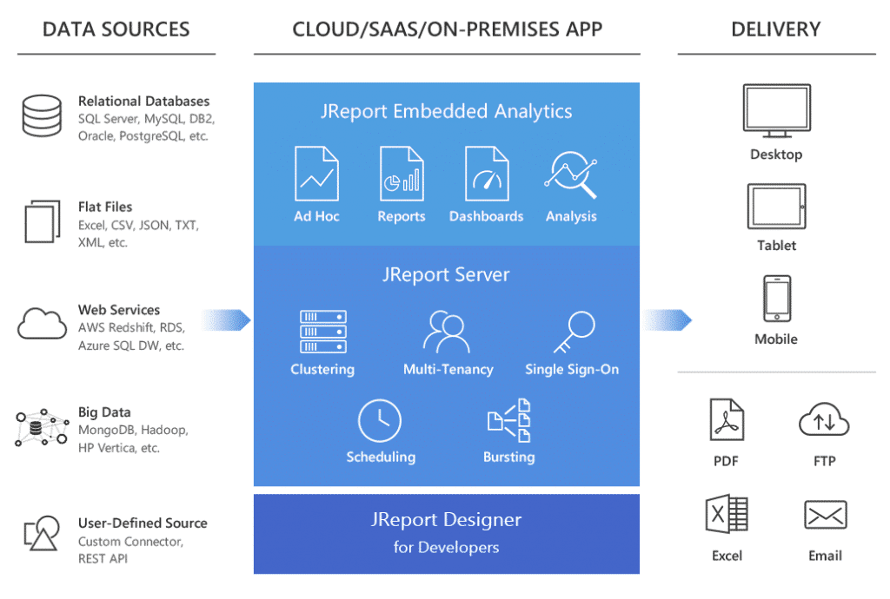
Notes:
An example of why Three-Tier is used. Requests from users on a variety of devices are formatted by the Web-App server into queries sent to data stores. Those Models return result sets to the Controller in the Web-App server which sends data formed into HTML, CSS, JavaScript, JSON objects to the View in the presentation layer which formats the content for the device.
https://www.jinfonet.com/wp-content/uploads/2017/12/3-tier-architecture-jreport-1-1024x690.png
https://www.jinfonet.com/resources/bi-defined/3-tier-architecture-complete-overview/

Slide 20
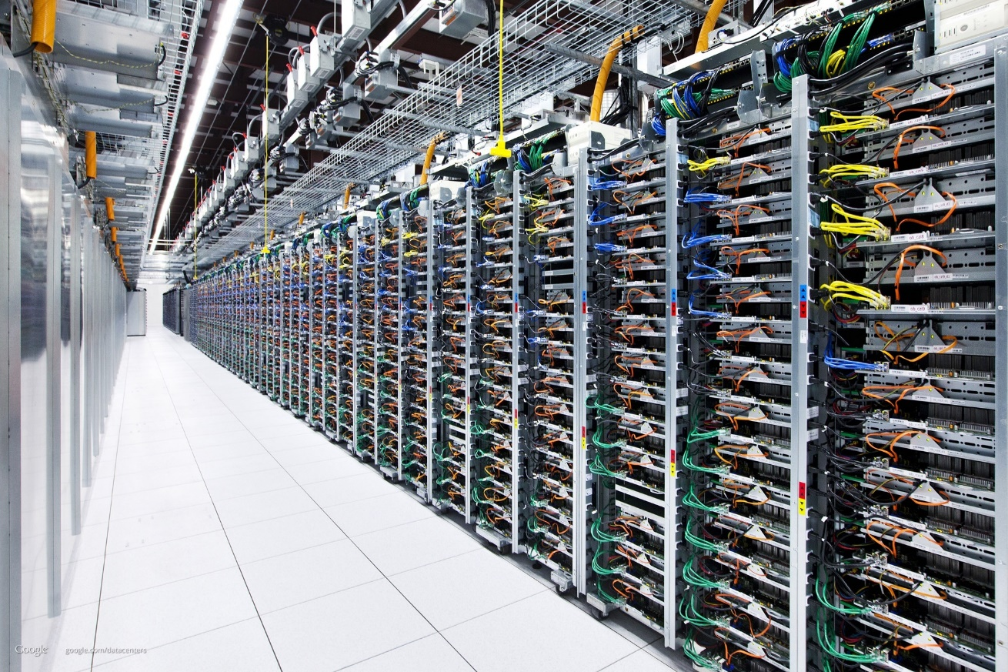

What cloud computing looks like…
Racks of servers with network cables.
Notes:
https://www.youtube.com/watch?v=XZmGGAbHqa0 Google data center
Fun fact: me.com is redirected to https://www.apple.com/icloud/ me.ca is available.
See https://cloud.ibm.com/
Photo source – https://bpr.berkeley.edu/wp-content/uploads/2014/12/servers-770x513.jpg
See also server-farm by laboratorio linux (CC BY-NC-SA 2.0) https://flic.kr/p/SQVdB4

Slide 21
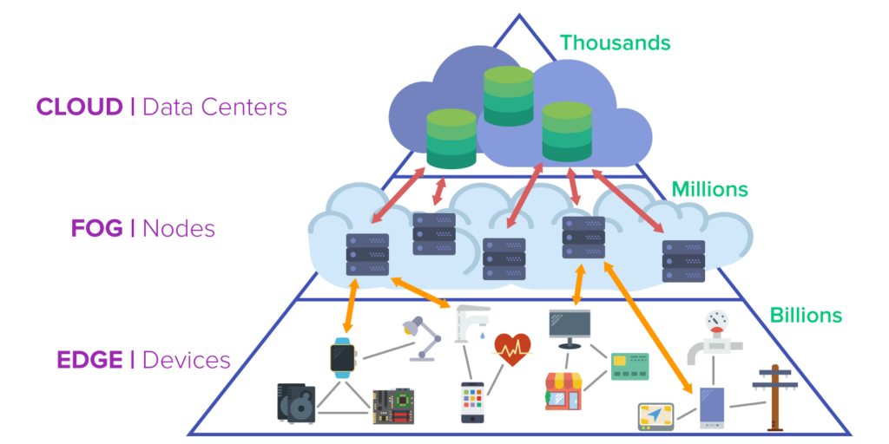
Notes:
As IoT and mobile devices rapidly increase in number, computing is being pushed outwards.
https://www.itworldcanada.com/article/microsoft-announces-azure-edge-zone-in-partnership-with-5g-carriers/429307
"Microsoft will be partnering with 5G carriers to release Azure Edge Zones and Azure Private Edge Zones.
As its name implies, the Azure Edge Zones are edge computing services that bring data computing power closer to the edge of the network, where the endpoint devices communicate with the service backend. … The goal is to bring ultra-low latency to time-sensitive applications such as gaming, game streaming, online events, and IoT."
https://en.wikipedia.org/wiki/Cloud_computing
https://en.wikipedia.org/wiki/Fog_computing
https://en.wikipedia.org/wiki/Edge_computing
Cloud computing has expanded to fog and to edge given the explosion of nodes and devices needing cloud services. Edge computing is also about devices talking directly to each other, e.g. cooperative autonomous vehicles which will negotiate directly with each other over 5G mesh networks to make real-time decisions without having to be connected through cloud services which would introduce too much latency.
AI ASIC on phones in next few years. Combined with 5G…look out!
https://medium.com/@alexanderderekrein/ai-asics-in-phones-what-it-means-for-the-world-and-you-9df18bb5c9e6
See https://www.cbinsights.com/research/5g-next-gen-wireless-system/ for overview.
https://www.itworldcanada.com/blog/an-innovative-framework-that-will-help-the-iot-industry-scale-into-the-billions/427907

Slide 22
Cloud Computing – thanks, Internet.
Remote server systems store, manage, and process data for small local servers, PCs, mobile devices, web apps.
Hosted infrastructure, development stacks, applications.
On demand resources rapidly provisioned and released.
Low admin, easy mgmt, low start up cost, highly scalable / elastic.
Distributed Computing: a 'cloud' of small remote servers, PCs, mobile devices supporting a single system.
Climate Prediction, SETI@home, Distributed Compute Labs
Notes:
Your data, your programming (IP), your web site, your business, and your livelihood is still on someone else’s computer. A high level of trust is assumed.
Scalable = quickly provision more always-on computing resources (satisfies growing need for long term resources )
Elastic = quickly and temporarily acquire more computing resources (high cost to satisfy peak demand but only for short periods)
Distributed Computing: instead of a single cloud system servicing many small devices, Distributed Computing is a cloud of small devices supporting a single system. Small systems on the 'EDGE' of the Internet process data with their spare CPU cycles and feed the results back to a single system to speed up CPU intensive tasks which would be too expensive and/or too slow to run in the traditional cloud or a local supercomputer.

Slide 23
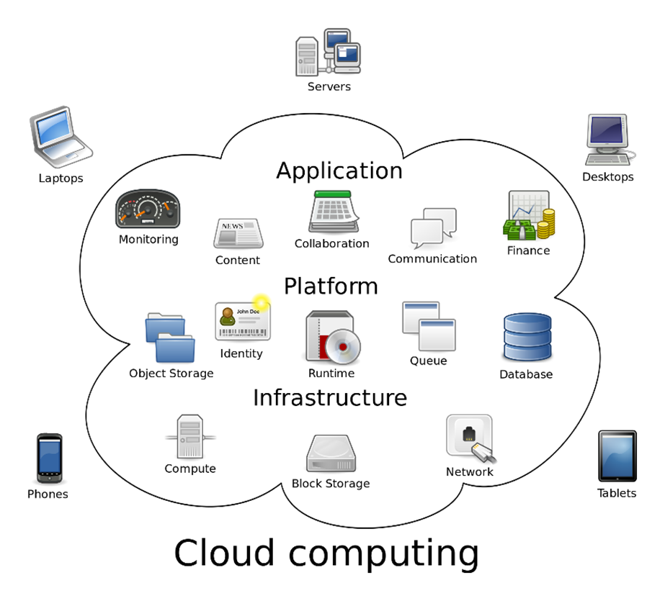
Clouds … as a Service
Software: SaaS
Platform: PaaS
Infrastructure: IaaS
Notes:
https://en.wikipedia.org/wiki/Cloud_computing#/media/File:Cloud_computing.svg
Remember, there is no such thing as the cloud when you are talking to IT professionals.
https://www.technologyreview.com/s/425970/who-coined-cloud-computing/
https://www.bbvaopenmind.com/en/10-myths-about-cloud-computing/
http://www.zdnet.com/article/stop-saying-the-cloud-is-just-someone-elses-computer-because-its-not/
Mary Branscombe, July 12, 2016, ZDnet:
The cloud is more than just someone else's computer accessible over the Internet. It is a high availability, “hyperscale, automated computer farm run by someone who's better at automation and security than you, and can buy electricity and servers and network connectivity more cheaply than you ”
“This is software-defined computing that's a step beyond hardware virtualisation; the CPU that runs the computation is a fungible resource that's allocated by software, at whatever level of abstraction you want. If you want a server to run your VM, you can have that. If you want to run PHP, Node or .NET code without caring where or how it runs, you can do that. If you want to stream sensor data from IoT devices or index a website or do any other arbitrary computation, you don't need a server to do that -- you just need the compute power available to you over the Internet.”

Slide 24
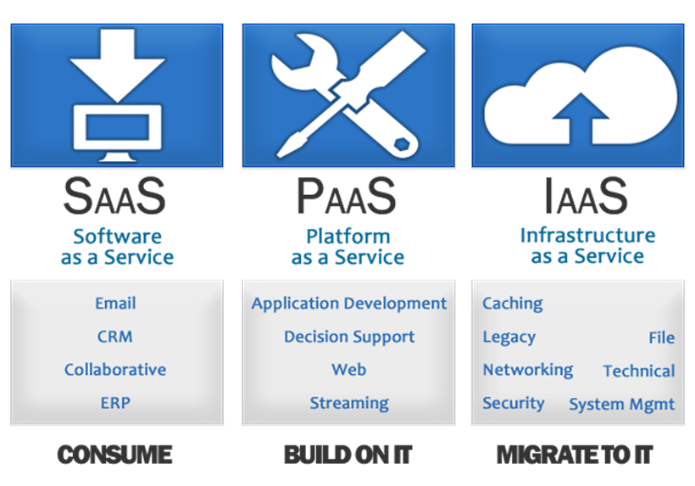
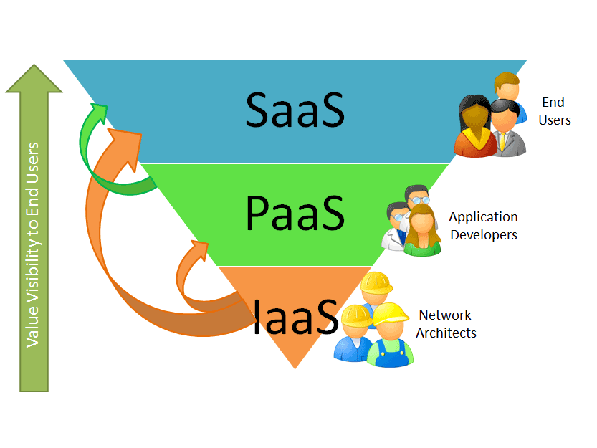
Cloud Computing Services
Notes:
This slide and the following slides are important because clients and colleagues will expect you to know the "cloud" has different levels of service.
Cloud Computing the practice of “using a network of remote servers on the Internet” to store, manage, and process data, rather than a local server or a personal computer.
provides “shared infrastructure, dev platform, or applications, on demand.”
rapidly provisioned (and released) with minimal management effort. Low start up cost.
However, your data, your programming (Intellectual Property), your web site, your business, and your livelihood is on someone else’s computer.
https://www.bmc.com/blogs/saas-vs-paas-vs-iaas-whats-the-difference-and-how-to-choose/
https://apprenda.com/library/paas/iaas-paas-saas-explained-compared/
https://www.cloudwards.net/understanding-cloud-terminology-what-does-iaas-paas-and-
-mean/
https://www.salesforce.com/ca/saas/
https://getnerdio.com/blog/10-popular-software-service-examples/
The authoritative definitions:
Evaluation of Cloud Computing Services Based on NIST SP 800-145 https://nvlpubs.nist.gov/nistpubs/SpecialPublications/NIST.SP.500-322.pdf This document provides clarification for qualifying a given computing capability as a cloud service by determining if it aligns with the NIST definition of cloud computing; and for categorizing a cloud service according to the most appropriate service model Software as a Service (SaaS), Platform as a Service, (PaaS), and Infrastructure as a Service (IaaS).

Slide 25
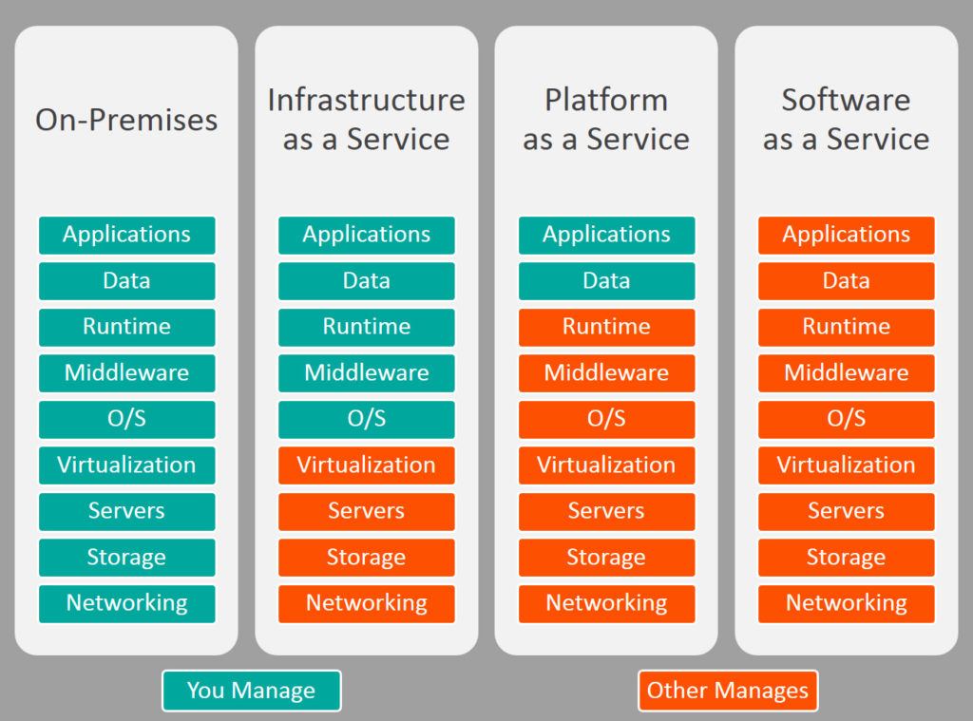
Technology Stack
your own car lease / rent taxi, uber public transit Full Stack
Cloud Computing
Notes:
Chart from
https://www.bmc.com/blogs/saas-vs-paas-vs-iaas-whats-the-difference-and-how-to-choose/
IaaS has a range like having a car but not owning it: You operate the hardware.
Leasing – you are responsible for everything except buying it and selling it.
Rental – short term needs, e.g. a truck or van
Subscription – includes insurance and flexibility in changing cars
Carshare – they cover everything including fuel and insurance
In every case, you still do the driving.
PaaS is using a car but not having to drive it. You bring the passengers and their luggage. You tell the driver where you want to go.
SaaS is using transportation services that already exist whether you use them or not. There is a small pay-per-use fee to get on. There is no setup or configuration. You do not tell the driver where you want to go; you get on and off at designated points. It is not as convenient but it is cheap and available…according to someone else's design and routing.
Very Full stack developers would use IaaS.
Dev stack developers use PaaS as would MEAN stack "full-stack" developers

Slide 26
Cloud Computing – IaaS Infrastructure as a Service
Infrastructure as a Service provides services such as networking, servers, storage space, and/or raw computing power to your client network.
High range of scalability and elasticity
Amazon Web Services (AWS). Google Compute Engine (GCP)
your ISP is your IaaS for your Internet connection.
Notes:
IaaS can eliminate capital expenditures companies traditionally make to buy their own on-premises hardware, IaaS can be a complete virtualized computer centre.
https://www.itworldcanada.com/article/head-start-helping-amazon-remain-the-top-public-cloud-provider-in-canada/402533
https://aws.amazon.com/directconnect/ <– uses "dark fiber"
With IaaS, a provider supplies the basic compute, storage and networking infrastructure along with the hypervisor (the virtualization layer). ICT admin users must then create virtual machines, install operating systems, support applications and data, and handle all of the configuration and management associated with those tasks. IaaS does not do much by itself, it is hardware/OS/networking you can use. IaaS is anything not on your premises but somehow connected to or supporting your system delivery at a low level.
https://cloud.google.com/
https://aws.amazon.com/
http://www.businessnewsdaily.com/5851-cloud-storage-solutions.html
http://searchcloudcomputing.techtarget.com/definition/Platform-as-a-Service-PaaS
Scaling Up or scalability is the ability to add capacity as your business grows or elasticity to deal with peaks in demand (concert tickets, Christmas buying season, weather and news events, US election night: the Canadian Immigration server (www.cic.gc.ca) crashed as the 2016 November USA election results were rolling in. The site went down about 10:30 p.m. ET that day with intermittent accessibility the next day or two until Americans got used to the idea that Donald Trump would be their new president.
Your ISP provides the networking infrastructure (Tier 3 connection to your house, physical nodes, routers, switches, network servers to Tier 2 network providers who then connect to Tier 1 backbones). For the most part, it is up to you how you use it. You hardly know your ISP is there except for your monthly billing. Infrastructure tends to be mostly invisible. Your ISP may provide other additional services but this is IaaS.
By contrast, IBM Capacity on Demand is a local version of this concept where you can turn on extra server capacity as you need it for your non-cloud infrastructure. It is literally extra CPUs built into the server on your premises which you pay a fee to activate.

Slide 27
Cloud Computing – PaaS Platform as a Service
PaaS does intelligent things with data you upload.
File/DB share, version, replicate, cache, synch.
APIs for many web services, blockchain BaaS
PaaS provides hosted software development stacks to create web applications.
Frameworks to build, debug, deploy, scale up/down.
Windows Azure runs your ASP.NET applications
Red Hat OpenShift on Red Hat OpenStack Platform
Google App Engine, Box.com
Notes:
With PaaS, a provider offers more of the application stack than IaaS providers, adding operating systems, middleware (such as databases) and other runtimes into the cloud environment. PaaS can eliminate capital expenditures companies traditionally make to buy their own on-premises hardware and software. Conceptually, PaaS is a Platform which runs on top of Infrastructure (Iaas).
A PaaS provider builds and supplies a resilient and optimized environment on which users (IT developers and administrators) can install applications and data sets. Developers focus on creating and running applications using the virtual PaaS. IT administrators do not have to construct and maintain the underlying infrastructure and services.
Many PaaS products are geared toward software development. These platforms offer compute and storage infrastructure, as well as text editing, version management, compiling and testing services that help developers create new software more quickly and efficiently. A PaaS product can also enable development teams to collaborate and work together, regardless of their physical location.
PaaS is how Shopify performs an average of 6,000 builds per weekday. They build their own PaaS configuration for their many developers to use.
https://www.infoq.com/news/2018/07/shopify-kubernetes-paas https://engineering.shopify.com/blogs/engineering/shopify-infrastructure-collaboration-with-google
Shopify is a Canadian e-commerce company that offers a proprietary e-commerce platform for online stores and retail point-of-sale systems. That is SaaS to their clients. Shopify currently has 3000+ employees, and the company processed $26 billion is transactions in 2017. The underlying e-commerce software platform sees 80k+ requests per second during peak demand and $82B in merchandise purchased through their systems. Shopify was started in 2004 in Ottawa by three snowboarders starting an online store to sell some high-end snowboards from small snowboard companies.
https://www.theglobeandmail.com/report-on-business/rob-magazine/meet-our-ceo-of-the-year/article21734931/
'The trouble was, the e-commerce software available at the time was, as far as Lütke was concerned, crap. It seemed to have been designed by people who had no experience in retailing. "The terminology was wrong, approach was wrong," says Lütke. "I'm like, You can't organize a business the way this software forces you to." '
– exactly. E-commerce platforms built in the previous 10 years during the rise of the Internet were designed by programmers who didn't understand the problem (online retailing) they were trying to solve.

Slide 28
Cloud Computing – SaaS Software as a Service
Software as a Service provides the user with fully functioning web based applications.
SalesForce CRM – the original SaaS.
Google Apps, Microsoft Office 365, BigBlueButton
Streaming services for consumers
eLearning: Cloud Computing Types
eLearning Tutorials Login needs your Seneca credentials and a LinkedIn account since LinkedIn bought Lynda
Notes:
Conceptually, SaaS runs on top of a Platform which runs on top of Infrastructure.
SaaS: There is a browser and software to interface with anything in the cloud (including IaaS and PaaS); don't think of SaaS as just software or that something is SaaS just because it runs in a browser. Think of SaaS as an application that provides sophisticated functionality to end users – the application itself runs in "the cloud" and is accessed via a browser which is essentially a dumb terminal with a good user interface; it can also run in a local tablet or smartphone app to provide better use of the hardware than a browser could. The browser is merely the delivery mechanism to the end user, it is not the defining characteristic of SaaS any more than the DEC VT-100 terminal represented UNIX. "An application program is a computer program designed to perform a group of coordinated functions, tasks, or activities for the benefit of the user. Wikipedia" SaaS does it over the Internet through a browser (or mobile app equivalent) – the only thing on the client end is the User Interface.
Used for Personal software delivery: having your own MS-Office products without managing installation and maintenance on your own machine.
More and more, SaaS is cooperative processing where people collaborate on documents and information centrally rather than the email attachment nightmare of distribution, version control, and amalgamation of revisions from individual documents.
Your ISP provides email –SaaS -- @theirDomain.ca to keep you as a customer. You could run your own email server with a permanent IP address but why bother?…unless you are Hillary Clinton and don’t trust the U.S. gov servers and don’t mind losing an election.
Office 365 Delve, Google Apps.
https://support.office.com/en-us/delve
Microsoft Office 365 is a combined application provided by Microsoft consisting of Microsoft Office Online (for Windows and OS X), Exchange (email), SharePoint (file repository/sharing), and storage space on OneDrive.

Slide 29
Peer to Peer and Blockchain need networks
A peer-to-peer (P2P) network is two or more systems sharing resources without using a central server (no central authority). BitTorrent protocol for file sharing
Advantages: low cost, easy to install, and no need for skilled staff, expensive servers, high bandwidth
Disadvantages: difficulty of administration, issues of security + trust, performance, scalability, reliability
Blockchain addresses security + trust
Notes:
P2P is decentralized computing or many-to-many processing. It is also the architecture of networks themselves. There is no “boss”, just organizational cooperation on standards. Each peer uses the same software to exchange information. (as opposed to client – server apps such as FTP where each end uses different software)
https://www.howtogeek.com/141257/htg-explains-how-does-bittorrent-work/
https://www.explainthatstuff.com/howbittorrentworks.html
https://superuser.com/questions/245390/how-does-bittorrent-work/274995#274995
https://en.wikipedia.org/wiki/BitTorrent
Disadvantages: there is no central authority to arbitrate disputes, balancing open cooperation (peering) with individual security is hard. Performance & reliability: if too many peers go offline, the overall P2P system will no longer work as well, e.g. bit torrent file sharing.
If all the peers must work cooperatively, scalability becomes an N-squared problem: every peer must talk to every other peer; with N peers, there are N-squared conversations.
Before blockchain, to use digital money, we needed a trusted third-party to keep a ledger of how much each of us has and owes, e.g. banks and credit card companies. With blockchain technology, a trusted third-party is not needed.
Real life Use Case: www.Ripple.com
Blockchain works on a distributed database that maintains a continuously-growing linked list of record sets called blocks. Each block contains a timestamp, a link and cryptographic hash code representing the contents of the previous block. By design blockchains are inherently resistant to modification of the data — once recorded, the data in any block cannot be altered (unless the cryptohash of every block in the chain is also altered and 51% of all other systems having the same blockchain also do this and agree – none of which can realistically happen)
https://marmelab.com/blog/2016/04/28/blockchain-for-web-developers-the-theory.html
How big is a block? A block is determined by size, e.g. 1MB, or time, e.g. Bitcoin generates a new block every 10 minutes, Ethereum does it every 10 seconds.
https://ftalphaville.ft.com/2017/11/22/2196054/taking-the-block-out-of-blockchain/
A mathematical problem is linked with each block. Miners are constantly processing and recording transactions; they race to ‘complete the current block’ in order to win Bitcoins. When a winning miner is able to solve it (computationally very difficult), the answer is shared with other mining nodes and it is validated (computationally very easy). Every time a miner solves a problem, a newly minted 12.5 BTC (Bitcoin currency symbol) is awarded to the miner and enters the circulation. The first record in that next block is a transaction that awards the winning miner (who completed the previous block) the newly minted BTC. https://www.investopedia.com/terms/b/block-bitcoin-block.asp
The Blockchain incentive for miners keeps them motivated to make the system more efficient – they participate in a competitive market – basic capitalism.
Through the use of a peer-to-peer network and a distributed timestamping server, a blockchain database is managed autonomously. It is a distributed trustless consensus of who has what.
Consensus: For me to send or receive money, I must recognize what’s presented to me really is money, and I must also know that everyone else will also recognize it as such. A medium of exchange is something we both agree as having the same value.
https://dev.to/damcosset/blockchain-what-is-in-a-block-48jo
Distributed: the system of peers must ensure consistency, that is when a transfer is made using the information supplied by one of the nodes it must be correctly reflected in all other nodes. There is no single source of "truth", everyone shares (and can individually verify) the same truth.
Trustless: you cannot trust any one peer but you can trust all the peers together. Peers perform work required to create consensus for the entire network, keeping the network sufficiently large that circumventing it becomes very expensive: a malicious peer would need enough computing power to compete with the entire existing network of peer to override consensus.
https://keepingstock.net/explaining-blockchain-how-proof-of-work-enables-trustless-consensus-2abed27f0845
From https://hackernoon.com/blockchains-dont-scale-not-today-at-least-but-there-s-hope-2cb43946551a …
Why isn’t the blockchain scalable?
Currently, all blockchain consensus protocols (eg. Bitcoin, Ethereum, Ripple, Tendermint) have a challenging limitation: every fully participating node in the network must process every transaction. Recall that blockchains have one inherent critical characteristic — “decentralization” — which means that every single node on the network processes every transaction and maintains a copy of the entire state. While a decentralization consensus mechanism offers some critical benefits, such as fault tolerance, a strong guarantee of security, political neutrality, and authenticity, it comes at the cost of scalability. The number of transactions the blockchain can process can never exceed that of a single node that is participating in the network. In fact, the blockchain actually gets weaker as more nodes are added to its network because of the inter-node latency that logarithmically increases with every additional node. In a traditional database system, the solution to scalability is to add more servers (i.e. compute power) to handle the added transactions. In the decentralized blockchain world where every node needs to process and validate every transaction, it would require us to add more compute to every node for the network to get faster. Having no control over every public node in the network leaves us in a pickle.
See (www.computerworld.com/article/2588287/networking/peer-to-peer-network.html)

Slide 30
Is sharing music/video files illegal?
© Copyright in Canada as of 2012:
Bill C-11, the Copyright Modernization Act, allows for private and personal use of time shifting, format shifting, and backup copies as long as no digital locks are involved.
online infringement of © — “notice-and-notice”
“notice-and-takedown” in USA and EU
Notes:
Bill C-11, the Copyright Modernization Act, allows for private and personal use of time shifting (PVR recording), format shifting (between different media, e.g. iTunes ←→ CD, for your own private and personal use), and making a backup copy only for backup/restore purposes. However, if there are digital locks on the media or the source is an on-demand service, the content cannot be copied; those things can be used/played/consumed only from the source media. You can legally lend a physical CD like you can lend a paper book, but you cannot "lend" digital data because the lending creates a copy which violates copyright (as it has always been in the case of copying a book).
e.g. can copy vinyl records or CDs (no digital locks) but cannot copy DVDs (having regional and digital locks).
Canada has charged a levy (AKA tariff) on "blank audio recording media", i.e. blank CDs since 1997 (0.29/disc) “Part VIII of the Copyright Act allows consumers to copy recorded music for their own personal use. In exchange, the private copying levy was created to compensate music rights holders for private copies made of their music. ” This was also done for blank cassette tapes in the era of LP vinyl records. The levy is collected regardless of the purchaser's end use of the media. The IT industry made major contributions to the music industry when CDs were a common backup and distribution medium for files that nevertheless paid the music levy.
http://www.cpcc.ca/en/ http://www.cpcc.ca/en/frequently-asked-questions
https://en.wikipedia.org/wiki/Private_copying_levy#Canada
https://www.theglobeandmail.com/business/commentary/article-after-supreme-court-decision-ottawa-must-fix-flaws-in-canadas/ The Canadian system for online infringement was formally established in 2012 and came into effect in 2015. The “notice-and-notice” approach grants rights holders the ability to send notifications of alleged infringement to internet providers, which are required by law to forward the notices to the relevant subscriber and to preserve the data in the event of future legal action. The system does not prevent rights holders from pursuing additional legal remedies but internet providers cannot reveal the identity of their subscribers without a court order.
https://www.theglobeandmail.com/business/commentary/article-five-critical-components-of-a-balanced-modern-canadian-copyright/
https://en.wikipedia.org/wiki/Copyright_Modernization_Act
http://www.barrysookman.com/2012/11/07/change-and-the-copyright-modernization-act/
http://www.barrysookman.com/2011/10/03/some-observations-on-bill-c-11-the-copyright-modernization-act/
http://www.huffingtonpost.ca/2015/01/08/michael-geist-copyright-modernization-act_n_6436584.html
http://business.financialpost.com/fp-tech-desk/pirates-in-your-neighbourhood-how-new-online-copyright-infringement-laws-are-affecting-canadians-one-year-later?__lsa=181b-aac5

Slide 31
File Sharing and Streaming
Technology is something that disrupts the ecology of space and time, even human relationships.
When you move bits instead of atoms, things change.
File Sharing & Distribution and Streaming Services are examples of that.
Notes:
the ecology of space and time: The electric light expands time, Skype and Facetime collapse the space between people. Airplanes remove the oceans between continents collapsing geography from a major expedition that could change your life to a test of one's comfort and sanity such that it feels like it is taking the rest of your life, a short journey across an endless space that seems as though it will never end.
Technology is something invented after you were born. Before that, existing technology was part of the ecosystem, part of reality, it was already there…to get water, you don't use 'technology', you turn on a tap –– there's no such thing as kitchen sink literacy. If you must adapt to it, then it is 'technology'. Social media is 'technology' for older people whose lives have been changed by their use of it. For younger people, social media is just how they live their lives; like the water a fish swims in, they are not even aware it is there. Social media is not change, it just is.
The big question, of course, is whether technology can solve the problems technology has created. The solution to the problem changes the problem.
The music business changed from live performances and sheet music to radio broadcasts and recorded music which copied the performance and reduced the need for sheet music (used for DIY performances). Vinyl LP discs in the 1950s and 60s were a great leap forward and record sales dominated the music industry. In the 1970s and 80s cassette tape began to erode vinyl but it was not a threat because copying had to happen in real time and there was a loss of quality. CDs eclipsed both LP records and cassettes by 1990. Unlike vinyl records, making perfect copies of CDs had become easy to do but only by the geeks and nerds with PCs and CD burners. With the rise of the Internet through the 1990s, CD atoms became MP3 bits. Bits are much easier to share than atoms. The bits became Napster – a central directory of sharable files on the Internet, which soon led to BitTorrent – a distributed directory of files on the Internet. The bits also became iPods and iTunes in 2001 which made CDs not worth the effort. Spotify and Netflix have made iTunes and file sharing not worth the effort. Now Spotify is making listening to songs not worth the effort.
The delivery of music has changed music. 78 rpm records in the first half of the 20th C limited musical performance to between 3 and 5 minutes. This continued with the later 45 rpm singles determining the length of popular songs and radio programming for almost a century. LP records stretched that time limit to 22+ minutes. Longer classical works could now be recorded but were still tweaked to fit. Tempos were sometimes increased, repeated sections of a score were dropped, multi-part works may not play back in order because, in the original sequence, they would not fit into 22 minute blocks. Beethoven's Ninth Symphony is arguable the greatest piece of western classical music. The first movement fits on side 1, the 2nd and 3rd movements fit on side 2 if all the repeats in the 2nd movement are dropped reducing its impact. This also made for some brisk performances of those middle movements. The 4th movement would just fit on to side 3 with some minor compromises. Any now, after those ~66 minutes of some of the greatest music ever composed, what do you put on side 4? Only silence can follow the 9th. If anyone ever listened to side 4, they never played it after side 3.
CDs play from the inside out allowing any size disc. So what size should a Compact Disc be? 120mm in diameter. That allowed for 74 minutes of music which, according to Phillip's official history, was specified by Sony executive Norio Ohga so Beethoven's Ninth Symphony would fit on one disc – all of it.
The change to digital file distribution from physical media should have removed any prescriptive limits on musical performances. It did for a while but now streaming has made it worse. Spotify is making listening to songs not worth the effort. Hit songs now feature shorter intros, fewer choruses, and shorter overall lengths. The length of the instrumental introduction to a pop song was 20 to 25 seconds in the mid-1980s. By 2015, the intro had shrunk down to a mere five seconds…the composer has to get the 'hook' in right away to 'grab' the streaming listener before they click NEXT. And the songs are shorter so you don't get bored…and click NEXT. Theme and variations is a dusty bit of musical history.
According to the Recording Industry Association of America, 75 per cent of music industry revenues now come from streaming. It cannot be ignored. We no longer invest in music for our enjoyment, that is, we don't buy songs or artists or albums. We have a service to all songs. It is a 'sunk cost', paid at the beginning of a month, available whether we use it or not. It is no longer the songs which have value, it is the curated list that panders to our taste and mood. The more songs we skip, the more the service plays songs we don't skip. Eventually, this reductive recursion will play only one song. We'll buy it on iTunes, cancel our streaming service, and set our single song playlist on repeat.
See https://www.cbc.ca/news/entertainment/streaming-songs-changes-1.5002748
In a study from January 2006, P2P (peer-to-Peer) BitTorrent traffic accounted for over 70% of all internet traffic. That has changed. Now, approximately that same amount of traffic is streaming services. https://torrentfreak.com/bittorrent-the-one-third-of-all-internet-traffic-myth/
Sandvine releases 2019 Global Internet Phenomena Report
https://www.sandvine.com/press-releases/sandvine-releases-2019-global-internet-phenomena-report
Video is over 60% of the total downstream volume of traffic on the internet. (Netflix, YouTube, Amazon Video, iTunes, Hulu, and others )
Netflix is 12.60% of the total downstream volume of traffic across the entire internet and 11.44% of all internet traffic.
Google is 12% of overall internet traffic, driven by YouTube, search, and the Android ecosystem.
Gaming traffic and gaming-related bandwidth consumption is increasing as gaming downloads, Twitch streaming, and eSports go mainstream.
BitTorrent is over 27% of total upstream volume of traffic, and over 44% in EMEA alone. (Europe, Middle East, Africa)
Facebook applications make up over 15% of the total internet traffic in APAC (Asia Pacific).

Slide 32
Notes
background info not on the quiz

Slide 33
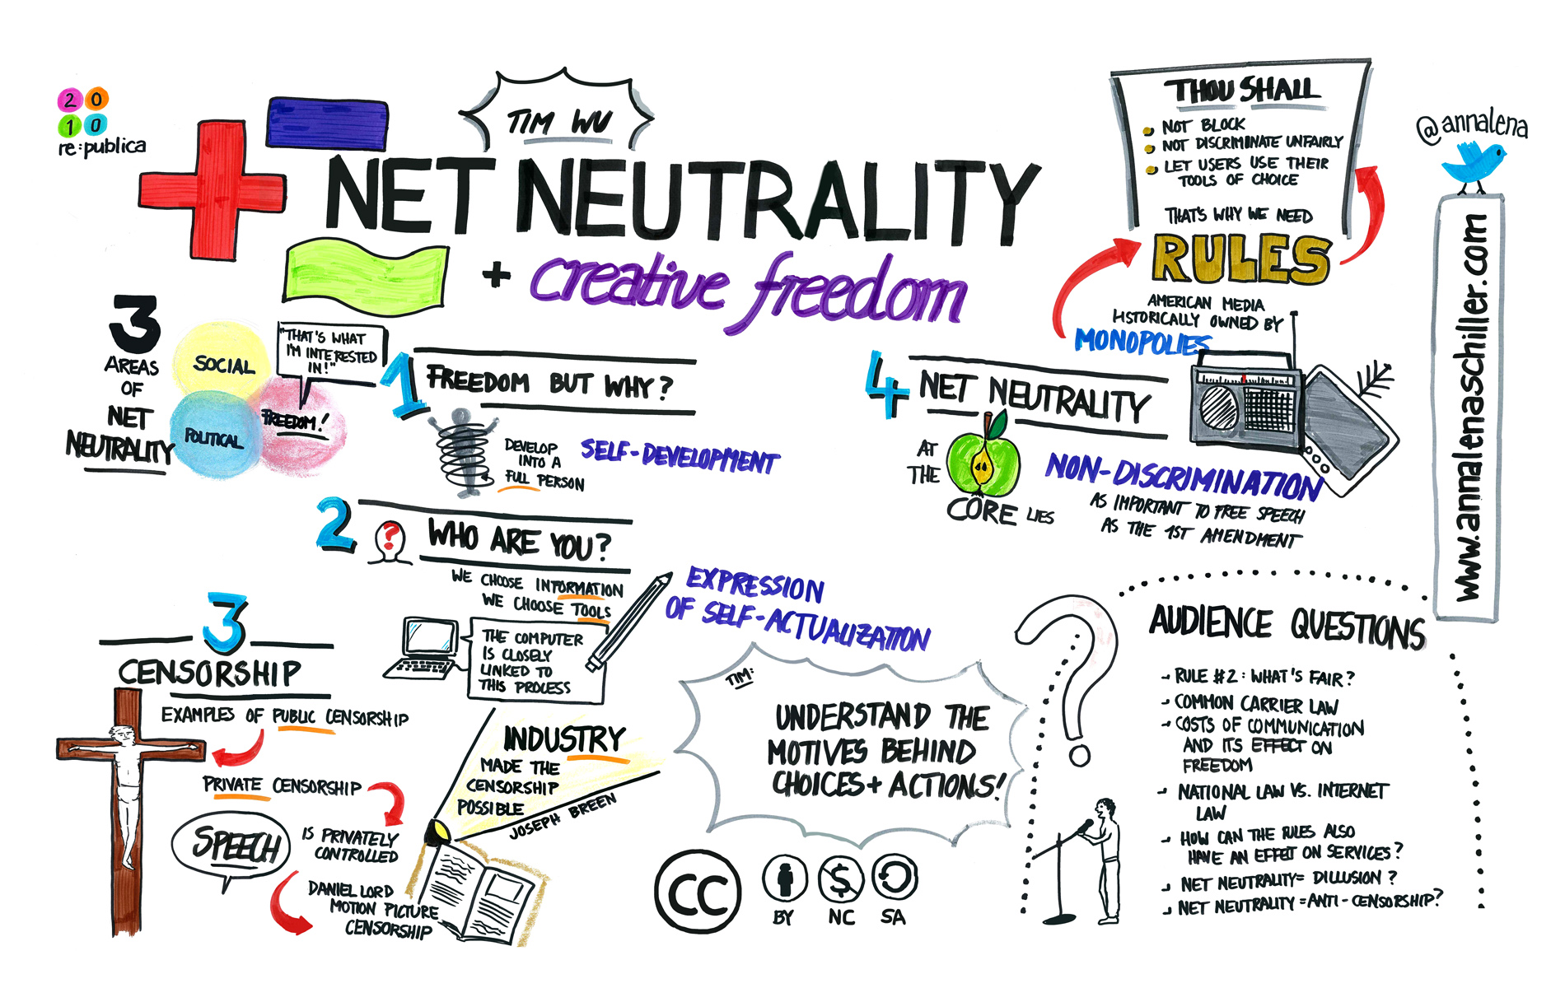
Net Neutrality (Tim Wu, 2003)
Principle of an open, neutral Internet:
Internet providers do not use their privileged position to favour some applications and services over others.
All packets are equal.
Notes:
Net Neutrality And Creative Freedom (Tim Wu at re:publica 2010) by Anna Lena Schiller (CC BY-NC-ND 2.0) https://flic.kr/p/7VfazT
https://en.wikipedia.org/wiki/Net_neutrality
http://www.michaelgeist.ca/tech-law-topics/net-neutrality/
https://spectrum.ieee.org/telecom/internet/net-neutralitys-technical-troubles
Net Neutrality's Technical Troubles
The debate has centered on policy, law, and finance, as if the network itself were a given. It is not.
What…does equal treatment mean? The Net needs to manage its diverse traffic, just as a city must manage the flow of pedestrians, bicycles, buses, delivery trucks, cars, and the occasional emergency vehicle on its streets. Any general rule must affect some kinds of traffic differently from the others, which is why you have car-friendly roads, bike lanes, and malls given over entirely to foot traffic.
Everyone who suffers from Internet traffic jams has a favorite villain. Streaming-video watchers blame carriers for throttling data flow to their phones or computers. Real-time gamers howl that delays and losses in data transmission hobble their competitive performance. This problem is so bad that Riot Games, maker of the popular League of Legends, plans to build a dedicated high-performance gaming network.
The stakes are rising with the promise of new Net applications, such as communication among autonomous vehicles. Also at stake is the future of wire-line telephone service, which FCC chairman Tom Wheeler wants to shift from aging landline networks to the Internet.
Yet so far the debate has centered on policy, law, and finance, as if the network itself were a given. It is not.
“There’s a lot of complexity here at a technical level that is absolutely lost in the policy conversations,” says Fred Baker, a distinguished engineering fellow at Cisco Systems and former chair of the Internet Engineering Task Force. Getting the technology right is crucial for the future of the Net.
The fundamental technical challenge is getting the Net to carry traffic that it was never meant to handle. Internet packet switching was designed for digital file transfers between computers, and it was later adapted for e-mail and Web pages. For these purposes the digital data does not have to be delivered at a specific rate or even in a specific order, so it can be chopped into packets that are routed over separate paths to be reassembled, in leisurely fashion, at their destinations.
By contrast, voice and video signals must come fast and in a specific sequence. Conversations become difficult if words or syllables go missing or are delayed by more than a couple of tenths of a second. Our eyes can tolerate a bit more variation in video than our ears can tolerate in voice; on the other hand, video needs much more bandwidth.
Voice and video can be converted into series of packets coded to identify their contents as requiring transmission at a regular rate. For telephony, the packet priority codes are designed to keep the conversation flowing without annoying jitter—variations in when the packets are received. Similar codes help keep video packets flowing at the proper rate.
In practice, these flow controls are not crucial in today’s fixed broadband networks, which generally have enough capacity to transmit voice and video. But mobile apps are a different story.
“Wireless has a lot of stuff moving around, so it needs much tighter management than wire line,” says a senior engineer at Nokia Networks, where he is responsible for innovation

Slide 34
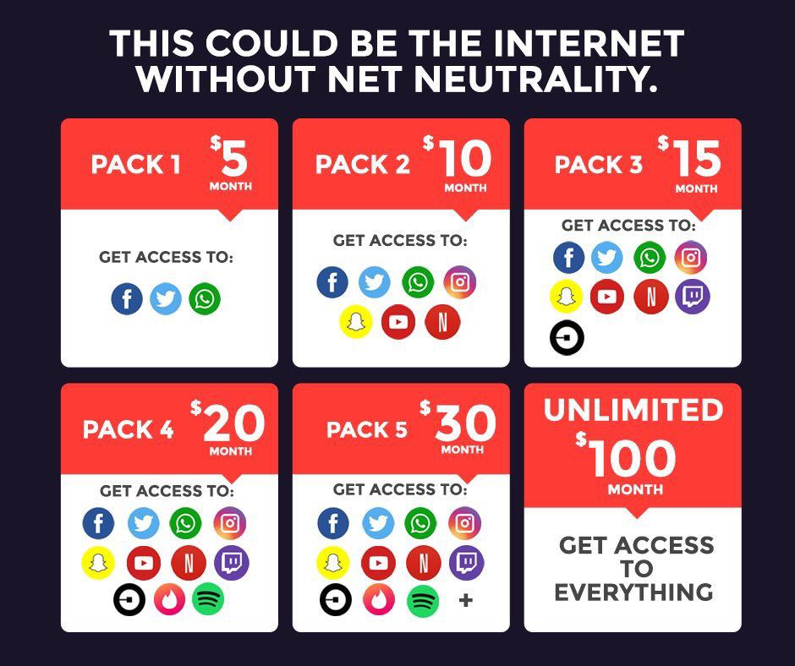

Slide 35
File Sharing
File Sharing is the practice of or ability to transmit files from one computer to another over a network or the Internet.
File sharing is the public or private sharing of computer data on a network, so that multiple people can access the data to their level of access privilege.
File sharing makes collaboration easier, but is also used for the illegal distribution of music, movies, software, and pornography.
Notes:
Deliberate file sharing via FTP or torrents
Vs
Automatic or synchronized file sharing via cloud services such as OneDrive and Sync
See https://www.cloudwards.net/online-storage-vs-online-backup-whats-the-difference/

Slide 36
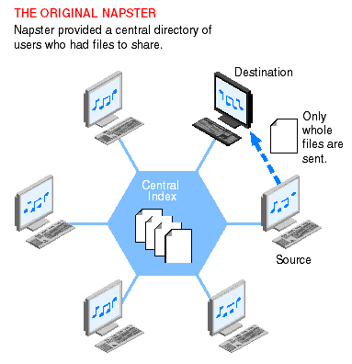
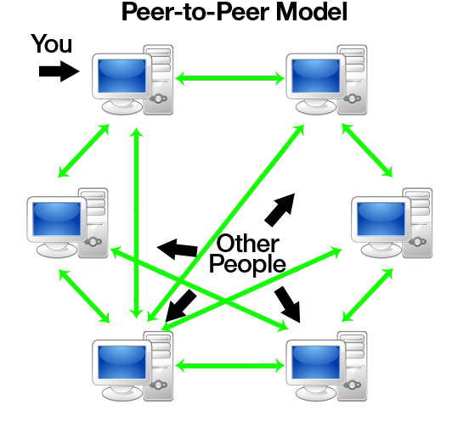
File Sharing: Napster vs BitTorrent
Notes:
Napster started 1999, based on P2P. Its “central database stored the location of all music files” (MP3). Individuals could request a song and the server would provide the location. “Peer computer would download the file directly to the requester.” Napster completely disrupted the music distribution business very quickly. As a result, it was sued by performers and other larger organizations. Napster ceased operations in 2002. It was reopened as an online store in 2006. Was bought by Best Buy in 2008 and sold to Rhapsody in 2011.
BitTorrent, since 2001, is a decentralized Peer-to-peer (P2P) architecture where portions of files can be exchanged. Several factors contributed to the widespread adoption and facilitation of peer-to-peer file sharing. These included increasing Internet bandwidth, the widespread digitization of physical media, and the increasing capabilities of residential personal computers.
P2P is not just for illegal file sharing, cracks, and warez. Microsoft uses it for Update distribution (Windows 10) and online playing games (the mmorpg Skyforge^{[2]}) use it as their content distribution network for downloading large amounts of data without incurring the dramatic costs for bandwidth inherent when providing just a single source.
In 2007, P2P file sharing accounted for 37% of Internet traffic. Today, that portion is streaming…mostly Netflix.
http://www.slideshare.net/srijish/p2p-principle-architecture-and-challenges-presentation
http://www.torrentkittytorrentkitty.com/history-of-torrent/
https://www.lifewire.com/free-p2p-file-sharing-software-programs-818053
https://en.wikipedia.org/wiki/Peer-to-peer_file_sharing

